Slide 2
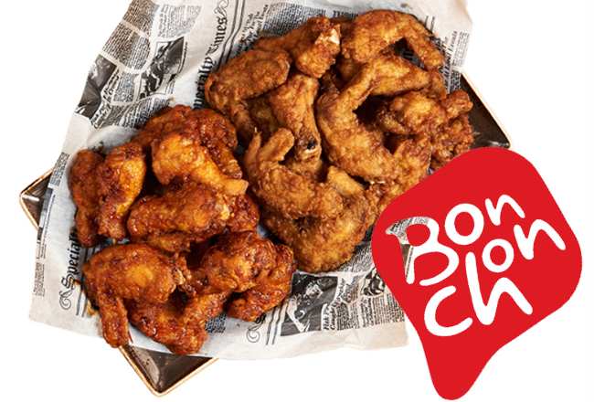

Slide 3
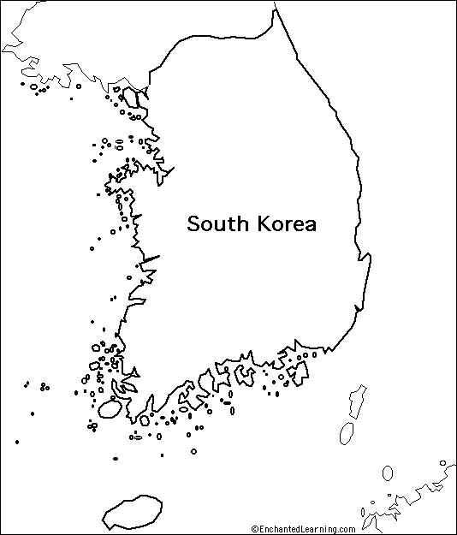

Slide 4
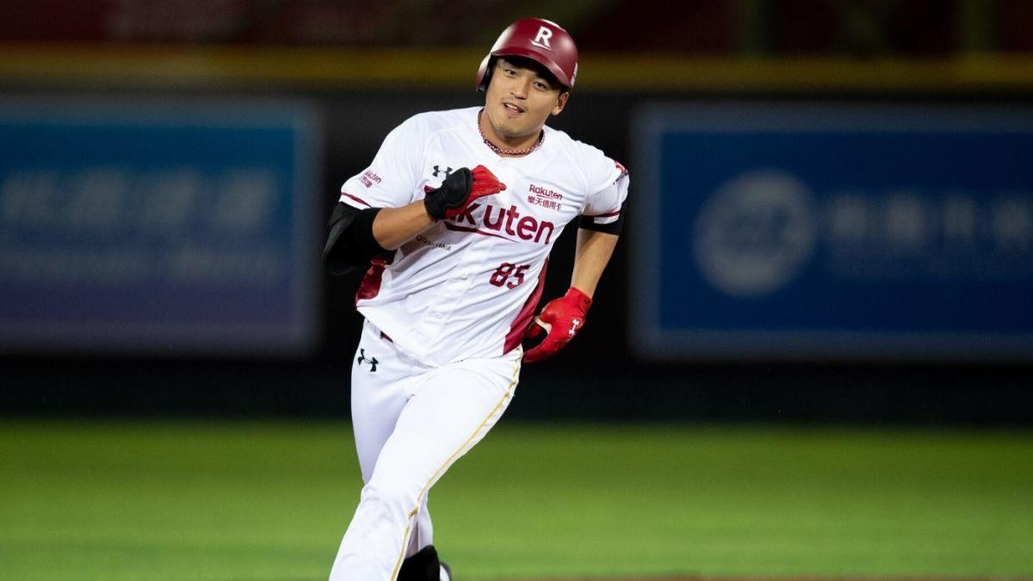

Slide 5
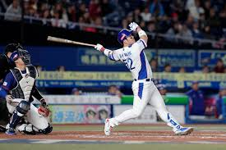
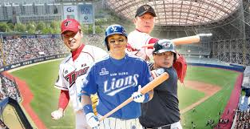

Slide 6
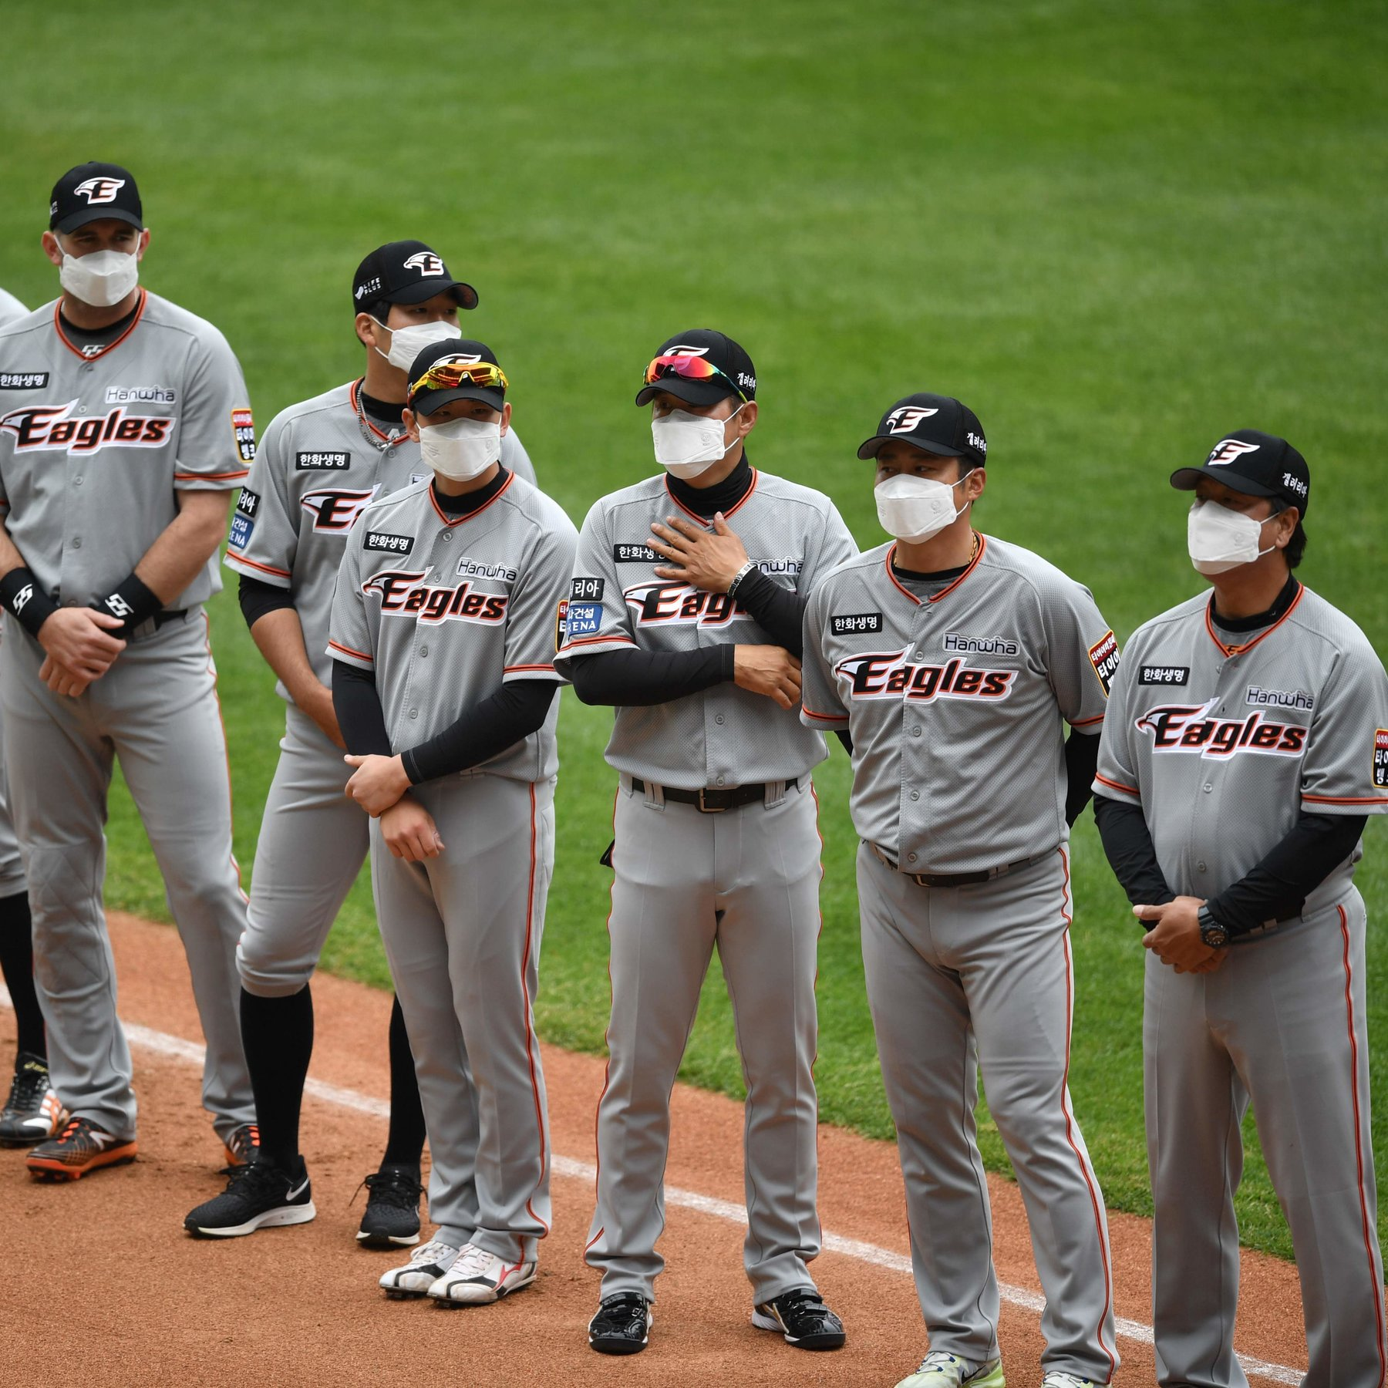
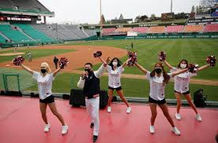

Slide 7


Slide 11
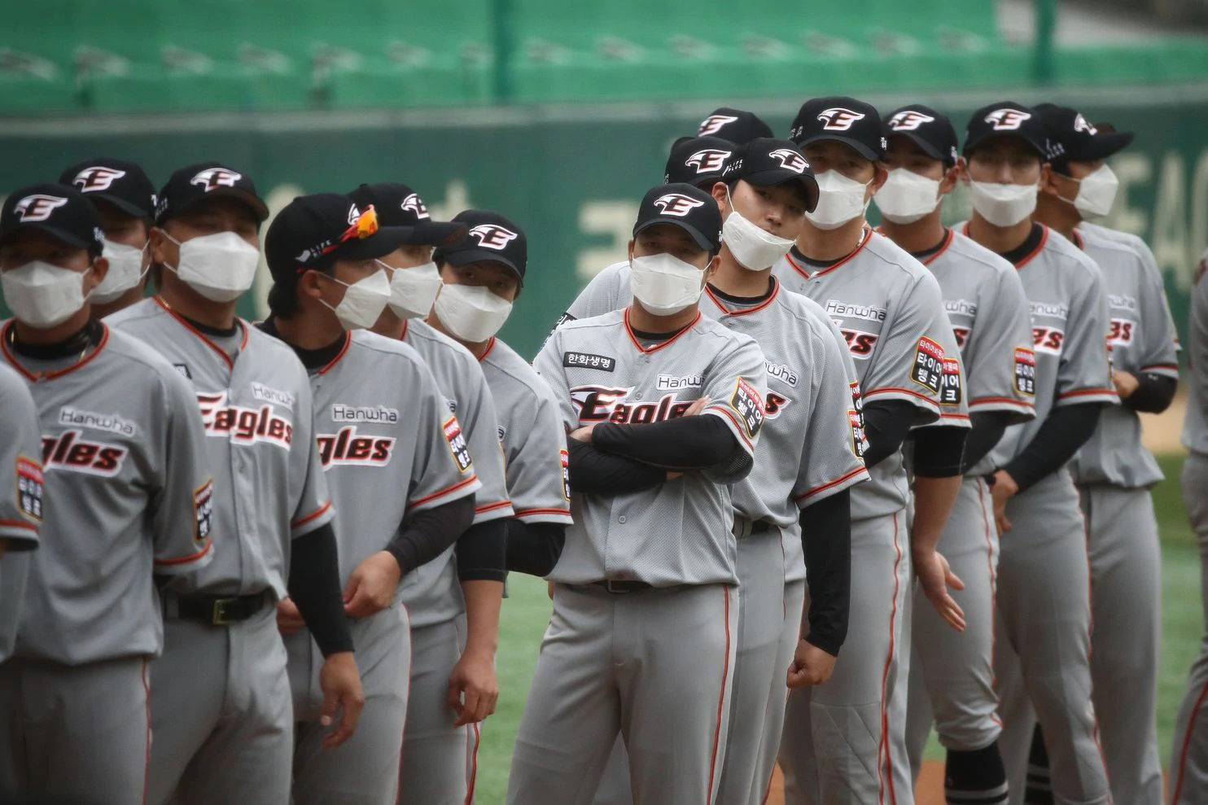

Slide 12
Projecting Player Performance

Slide 13
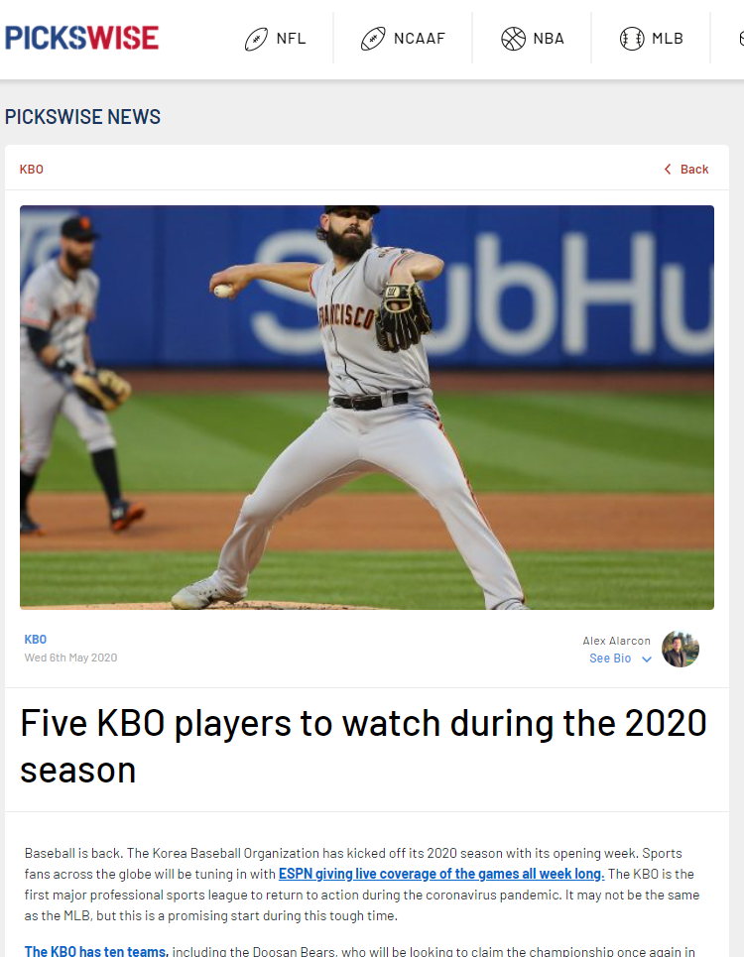

Slide 14


Slide 15
2019 League Leaders

Slide 16
2019 League Leaders
Ui-ji Yang

Slide 17
2019 League Leaders
Ui-ji Yang
↓ #7

Slide 18
2019 League Leaders
Ui-ji Yang
ByungHo Park
↓ #7

Slide 19
2019 League Leaders
Ui-ji Yang
ByungHo Park
↓ #7
↓ #37

Slide 20
2019 League Leaders
Ui-ji Yang
ByungHo Park
Jerry Sands
↓ #7
↓ #37

Slide 21
2019 League Leaders
Ui-ji Yang
ByungHo Park
Jerry Sands
↓ #7
↓ #37
Japan

Slide 22
2019 League Leaders
Ui-ji Yang
ByungHo Park
Jerry Sands
Jeong Choi
↓ #7
↓ #37
Japan

Slide 23
2019 League Leaders
Ui-ji Yang
ByungHo Park
Jerry Sands
Jeong Choi
↓ #7
↓ #37
Japan
↓ #14

Slide 24
2019 League Leaders
Ui-ji Yang
ByungHo Park
Jerry Sands
Jeong Choi
Baek-ho Kang
↓ #7
↓ #37
Japan
↓ #14

Slide 25
2019 League Leaders
Ui-ji Yang
ByungHo Park
Jerry Sands
Jeong Choi
Baek-ho Kang
↓ #7
↓ #37
Japan
↓ #14
↓ #10

Slide 26
2019 League Leaders
Ui-ji Yang
ByungHo Park
Jerry Sands
Jeong Choi
Baek-ho Kang
↓ #7
↓ #37
Japan
↓ #14
↓ #10

Slide 27
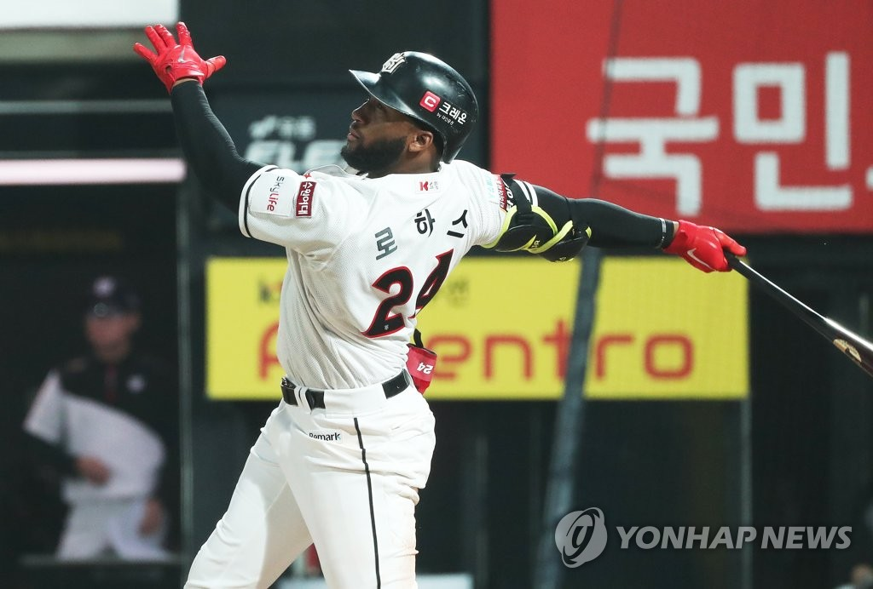
Mel Rojas Jr. (!)

Slide 28
Better Way?

Slide 29
Better Way?
Data Science!

Slide 30
Data Wrangling

Slide 31
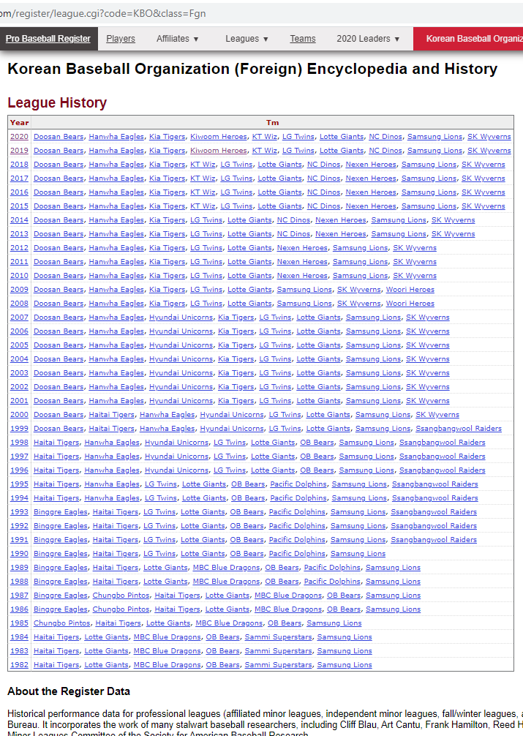
Data Wrangling
Web Scraping

Slide 32
Data Wrangling
Web Scraping
(every season in KBO history)

Slide 33
EDA

Slide 34
EDA: Define data relationships

Slide 35
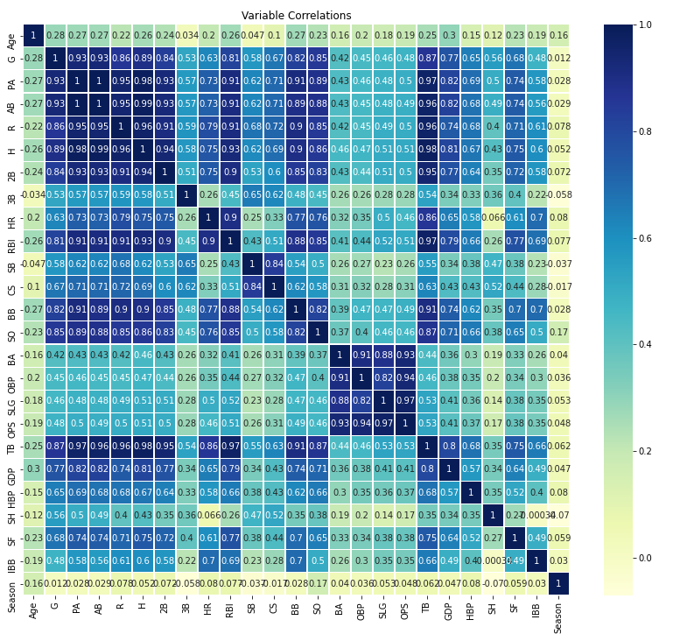
EDA: Define data relationships

Slide 36
EDA: Define data relationships
Lots of potential predictive features

Slide 37
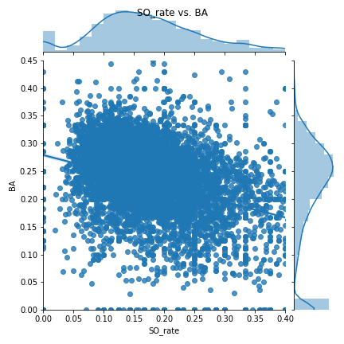
EDA: Define data relationships

Slide 38
EDA: Define data relationships
↑ Strike Outs : ↓ Batting Average

Slide 39
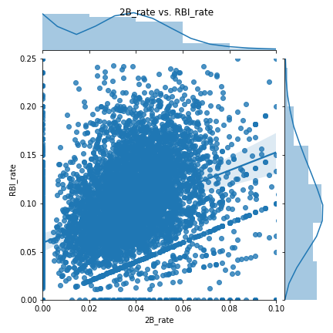
EDA: Define data relationships
↑ Doubles : ↑ RBIs

Slide 40
Processing, Model Selection

Slide 41
Processing, Model Selection
Considered 6 models

Slide 42
Processing, Model Selection
Considered 6 models
Checked RMSE for each response variable

Slide 43
Processing, Model Selection
Considered 6 models
Checked RMSE for each response variable
Ridge Regressor consistently best

Slide 44
Model: Ridge Regressor

Slide 45
Model: Ridge Regressor
Good with multicollinearity

Slide 46
Model: Ridge Regressor
Good with multicollinearity
Not computationally intensive

Slide 47
Hyperparameter Tuning

Slide 48
Hyperparameter Tuning
Three different response variables

Slide 49
Hyperparameter Tuning
Three different response variables
Alpha

Slide 50
Hyperparameter Tuning
Three different response variables
Alpha
Solver

Slide 51
Hyperparameter Tuning
Three different response variables
Alpha
Solver
Wide GridSearchCV

Slide 52
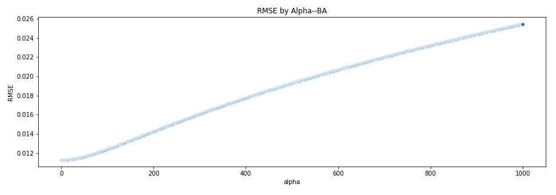
Hyperparameter Tuning

Slide 53
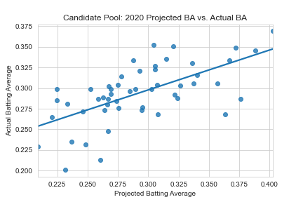
Model Performance

Slide 54
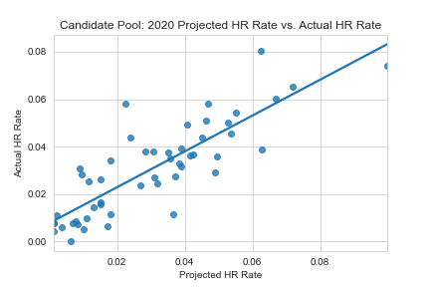
Model Performance

Slide 55
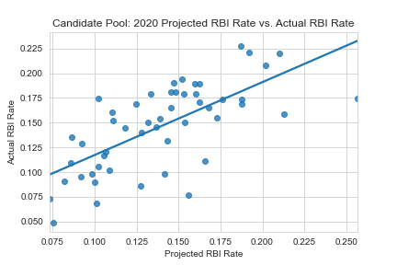
Model Performance

Slide 56
Model Sponsor Picks

Slide 57
Model Sponsor Picks
Roberto Ramos

Slide 58
Model Sponsor Picks
Roberto Ramos
↓ #6

Slide 59
Model Sponsor Picks
Roberto Ramos
Mel Rojas Jr.
↓ #6

Slide 60
Remember me?

Slide 61
Model Sponsor Picks
Roberto Ramos
Mel Rojas Jr.
↓ #6
↑ #1

Slide 62
Model Sponsor Picks
Roberto Ramos
Mel Rojas Jr.
Dong-Won Park
↓ #6
↑ #1

Slide 63
Model Sponsor Picks
Roberto Ramos
Mel Rojas Jr.
Dong-Won Park
↓ #6
↑ #1
↓ #32*
*Injured

Slide 64
Model Sponsor Picks
Roberto Ramos
Mel Rojas Jr.
Dong-Won Park
Sung-Bum Na
↓ #6
↑ #1
↓ #32*
*Injured

Slide 65
Model Sponsor Picks
Roberto Ramos
Mel Rojas Jr.
Dong-Won Park
Sung-Bum Na
↓ #6
↑ #1
↓ #32*
↑ #2
*Injured

Slide 66
Model Sponsor Picks
Roberto Ramos
Mel Rojas Jr.
Dong-Won Park
Sung-Bum Na
Jose Miguel Fernandez
↓ #6
↑ #1
↓ #32*
↑ #2
*Injured

Slide 67
Model Sponsor Picks
Roberto Ramos
Mel Rojas Jr.
Dong-Won Park
Sung-Bum Na
Jose Miguel Fernandez
↓ #6
↑ #1
↓ #32*
↑ #2
↓ #8
*Injured

Slide 68
Model Sponsor Picks
Roberto Ramos
Mel Rojas Jr.
Dong-Won Park
Sung-Bum Na
Jose Miguel Fernandez
↓ #6
↑ #1
↓ #32*
↑ #2
↓ #8
*Injured

Slide 69
Model Sponsor Picks
Roberto Ramos
Mel Rojas Jr.
Dong-Won Park
Sung-Bum Na
Jose Miguel Fernandez
↓ #6
↑ #1
↓ #32*
↑ #2
↓ #8
vs. Naive (2019 Leaders)
*Injured

Slide 70
Model Sponsor Picks
Roberto Ramos
Mel Rojas Jr.
Dong-Won Park
Sung-Bum Na
Jose Miguel Fernandez
↓ #6
↑ #1
↓ #32*
↑ #2
↓ #8
vs. Naive (2019 Leaders)
Top 5: 42% better
*Injured

Slide 71
Model Sponsor Picks
Roberto Ramos
Mel Rojas Jr.
Dong-Won Park
Sung-Bum Na
Jose Miguel Fernandez
↓ #6
↑ #1
↓ #32*
↑ #2
↓ #8
vs. Naive (2019 Leaders)
Top 5: 42.4% better
Top 10: 12% better
*Injured

Slide 72
Business Insights

Slide 73
Business Insights
Use these recs

Slide 74
Business Insights
Use these recs
Deeper understanding

Slide 75
Business Insights
Use these recs
Deeper understanding
Feature relationships

Slide 76
Future Work

Slide 77
Future Work
More detailed data

Slide 78
Future Work
More detailed data
Past season performance

Slide 79
Future Work
More detailed data
Past season performance
Pitcher performance

Slide 80
Future Work
More detailed data
Past season performance
Pitcher performance
Smaller scale predictions

Slide 81
Future Work
More detailed data
Past season performance
Pitcher performance
Smaller scale predictions
Game-by-game
Individual at-bats
Individual pitches

Slide 82
Appendix
This capstone project was completed for the Springboard Data Science Career Track.
The intended hypothetical audience for this presentation is the Bonchon executive board, with some technically minded members attending.
The main goal was to project
The Github repository for this project can be found here: https://github.com/abewoycke/KBO-Projections

